Slide 1


IOT-BASED HOME AUTOMATION
Shri Vishnu Engineering College for Women (AUTONOMOUS)
Shri Vishnu Engineering College For Women
(Autonomous)
Department of Electrical and Electronics Engineering
Project Guide:
Ms.G.Bharathi
Sr. Asst Professor
Department of EEE
Project Associates:
V. J S Meghana(23B01A0255)
P.Suseela Devi(23B01A0240)
P. Mounika(23B01A0242)
K.Kundana Sai(24B05A0206)

Slide 2
Problem Statement
In many households, electrical appliances are operated manually and lack remote access, leading to inconvenience and inefficient energy usage. Users often forget to switch off appliances when they are away from home, resulting in unnecessary power consumption and increased electricity bills. Existing automation solutions are either expensive, complex, or fully dependent on internet connectivity, making them unreliable in certain situations. Hence, there is a need for a simple, affordable, and flexible home automation system that provides both smart and manual control.
Key Problems Identified:
Lack of remote control over household appliances
Energy wastage due to appliances left ON unintentionally
High cost and complexity of existing automation systems
Dependence on internet connectivity without manual backup

Slide 3
Abstract
Home Automation system using IOT is a system that uses computers or mobile devices control basic home functions and features automatically through internet from anywhere. It is meant to save the electric power and human energy. The home automation system differs from other system by allowing the user to operate the system from anywhere through internet connection. It involves the creation of the system that can operate, control and monitor various tasks.
This Automation can be applied in various applications including Manufacturing, Agriculture, IT and many applications. This system is designed to be low cost and expandable allowing a variety of devices to be controlled .Electrical and Electronic appliances in the home such as fan, lights, outdoor lights, fire alarm, kitchen timer, etc., can be controlled using various control techniques. In recent years, wireless systems like Wi Fi have become more and more common in home networking.

Slide 4
Objectives
To enable remote control of household appliances through mobile applications and
voice assistants such as Google Assistant and Alexa.
To reduce energy consumption and power wastage by providing efficient appliance control.
To ensure reliable operation by incorporating both smart control and manual switch modes.
To develop a low-cost, user-friendly, and scalable solution suitable for real-world home
automation applications.
To design and develop an IoT-based home automation system using the ESP32 microcontroller.

Slide 5
Components Required
Components for Hardware
ESP 32 Dev Module
4 Channel Relay Module
Jumper Wires
Manual Switches
4 Bulbs
Components for Software
Arduino IDE
ESP Rain Maker App

Slide 6
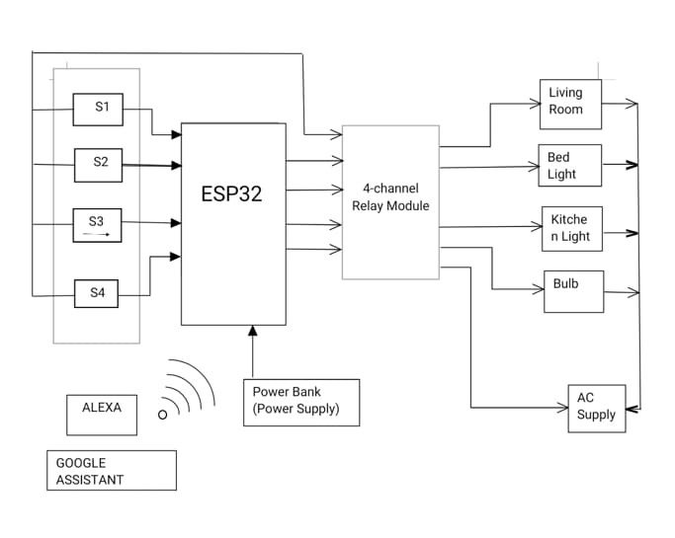
Block Diagram

Slide 7
Methodlogy
The methodology of this project design includes the implementation of the proposed method. Here we have divided into two main categories.
1. Hardware
2. Software
1. Hardware
It would also be able to turn on/off specified devices, such as lights and fans. It is called the ‘Control Unit’. In this project, the hardware components are
• ESP32 Dev Module
• 4-Channel Relay Module
• Jumping wires
• Manual Switches
2. Software
ESP32 Dev Module: ESP32 is a series of low-cost, low-power system-on-chip microcontrollers with integrated Wi-Fi and dual-mode Bluetooth. We can program the ESP32 in a variety of languages.
Wi-Fi range –500m to 200 m.
voltage range –2.2v to 3.6v.
4 Channel Relay Module: The 4 Channel Relay Module is a convenient board which can be used to control high voltage, high current loads such as motors, lamps and AC loads. By this, we can switch on or off the different circuits.It contains 4 separate relays.

Slide 8
Procedure
1. Connect the ESP32, 4-channel relay module, sensors and switches to the PCB as per the block diagram.
2. Install the ESP32 board manager.
3. Upload code to ESP32 using Arduino IDE.
4. Install the ESP Rain Maker Application.
5. When we command the to ESP32 get a command from the user and send it to IOT platform(App), it reads and gives back to the ESP, and then the relay will trigger the device. It acts as a switch.
6. Then, after the software has executed.

Slide 9
Project Outcome
Successfully designed and implemented an IoT-based home automation system using the ESP32 microcontroller.
Household appliances were controlled effectively through Google Assistant, Amazon Alexa, mobile application, and manual switches.
The system demonstrated reliable operation both with and without internet connectivity, ensuring uninterrupted control.
The project helped in reducing energy wastage by enabling timely ON/OFF control of appliances.
A low-cost, scalable, and user-friendly solution was achieved, suitable for practical smart home applications.

Slide 10
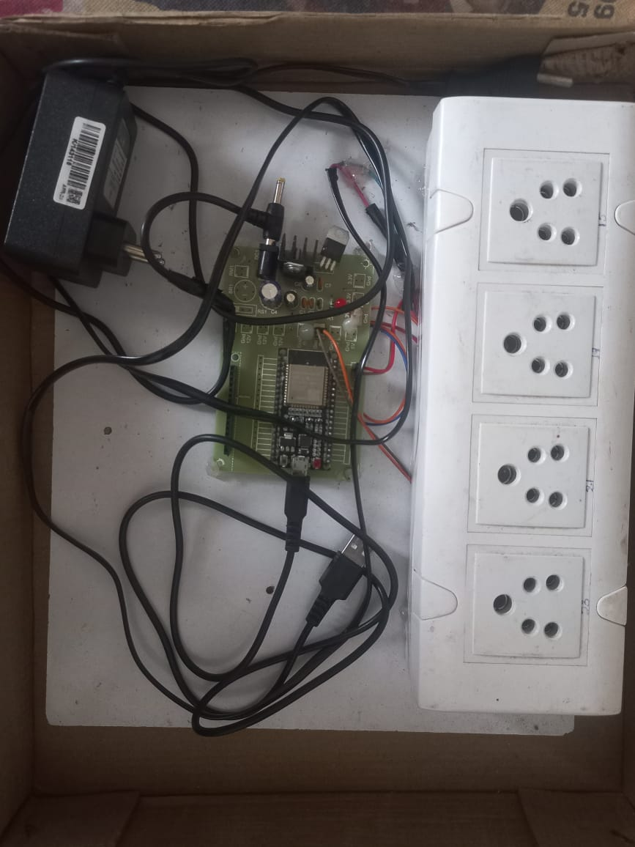
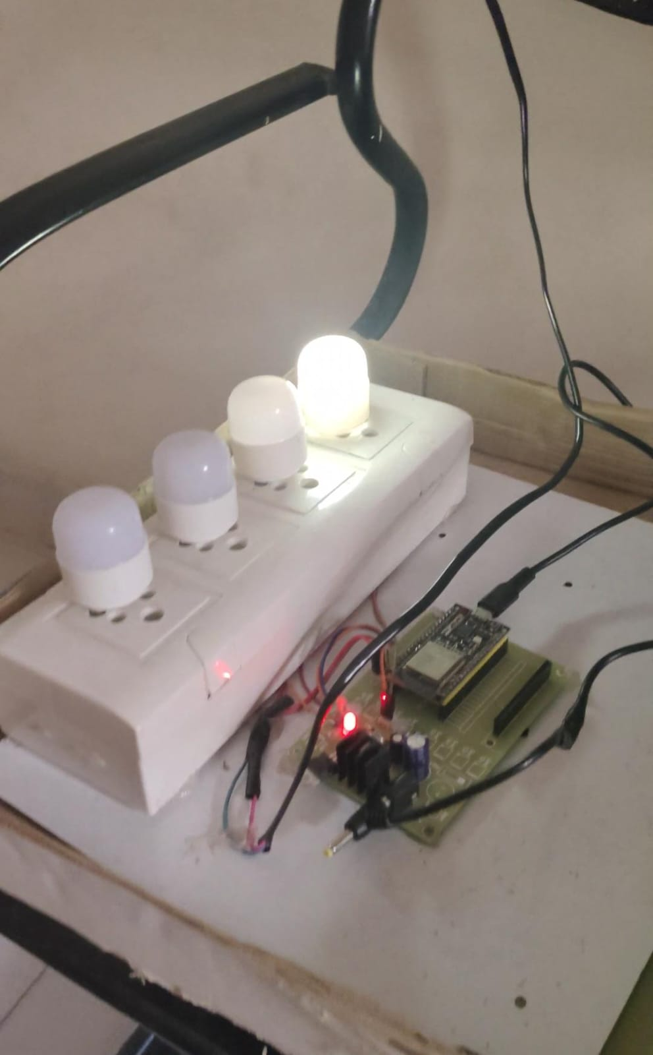

Slide 11
Thank you

